Slide 1

The history of SportS... Which one is for me?
Jorge Solana Pérez

Slide 2
What have I done…?
Historical study of the las 30 years of the earnings of the top sports

Slide 3
What have I done…?
Historical study of the las 30 years of the earnings of the top sports
Predictions for the next 10 years

Slide 4
What have I done…?
Historical study of the las 30 years of the earnings of the top sports
Predictions for the next 10 years
Abilities exploration

Slide 5
What have I done…?
Historical study of the las 30 years of the earnings of the top sports
Predictions for the next 10 years
Abilities exploration
Feedback for the best suitable sport for the userr

Slide 6

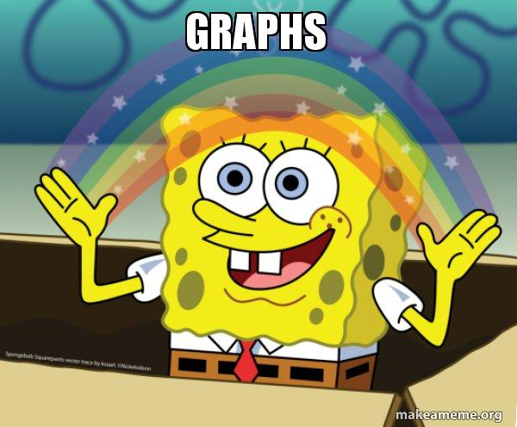
Why have I done this?
Summarizing…. I am complete sports freak and I love graphs with a good storytelling

Slide 7
What have I used?
For obtaining the data I picked two different datasets in Kaggle

Slide 8
What have I used?
For obtaining the data I picked two different datasets in Kaggle
For all my graphs I used visualization tools available in Python such as Seaborn and Plotly

Slide 9
What have I used?
For obtaining the data I picked two different datasets in Kaggle
For all my graphs I used visualization tools available in Python such as Seaborn and Plotly
For the clusters in sports I used a K-Means model from sckit-learn

Slide 10
What have I used?
For obtaining the data I picked two different datasets in Kaggle
For all my graphs I used visualization tools available in Python such as Seaborn and Plotly
For the clusters in sports I used a K-Means model from sckit-learn
For the prediction of the next 10 years I used a polynomic regression model

Slide 11
What have I used?
For obtaining the data I picked two different datasets in Kaggle
For all my graphs I used visualization tools available in Python such as Seaborn and Plotly
For the clusters in sports I used a K-Means model from sckit-learn
For the prediction of the next 10 years I used a polynomic regression model
For giving back the best suitable sport of a user I used an approximation approach (I will dive into that later on)

Slide 12
Steps for achieving my goal
Download the data

Slide 13
Steps for achieving my goal
Download the data
Explore, dive and end up soaked in my data

Slide 14
Steps for achieving my goal
Download the data
Explore, dive and end up soaked in my data
Clean, clean, clean

Slide 15
Steps for achieving my goal
Download the data
Explore, dive and end up soaked in my data
Clean, clean, clean
Plot, plot plot

Slide 16
Steps for achieving my goal
Download the data
Explore, dive and end up soaked in my data
Clean, clean, clean
Plot, plot plot
Predicting the next 10 years by a polynomic regression

Slide 17
Steps for achieving my goal
Download the data
Explore, dive and end up soaked in my data
Clean, clean, clean
Plot, plot plot
Predicting the next 10 years by a polynomic regression
Clusterizing all my sports with K-Means

Slide 18
Steps for achieving my goal
Download the data
Explore, dive and end up soaked in my data
Clean, clean, clean
Plot, plot plot
Predicting the next 10 years by a polynomic regression
Clusterizing all my sports with K-Means
Predicting your best sport with an approximation approach

Slide 19
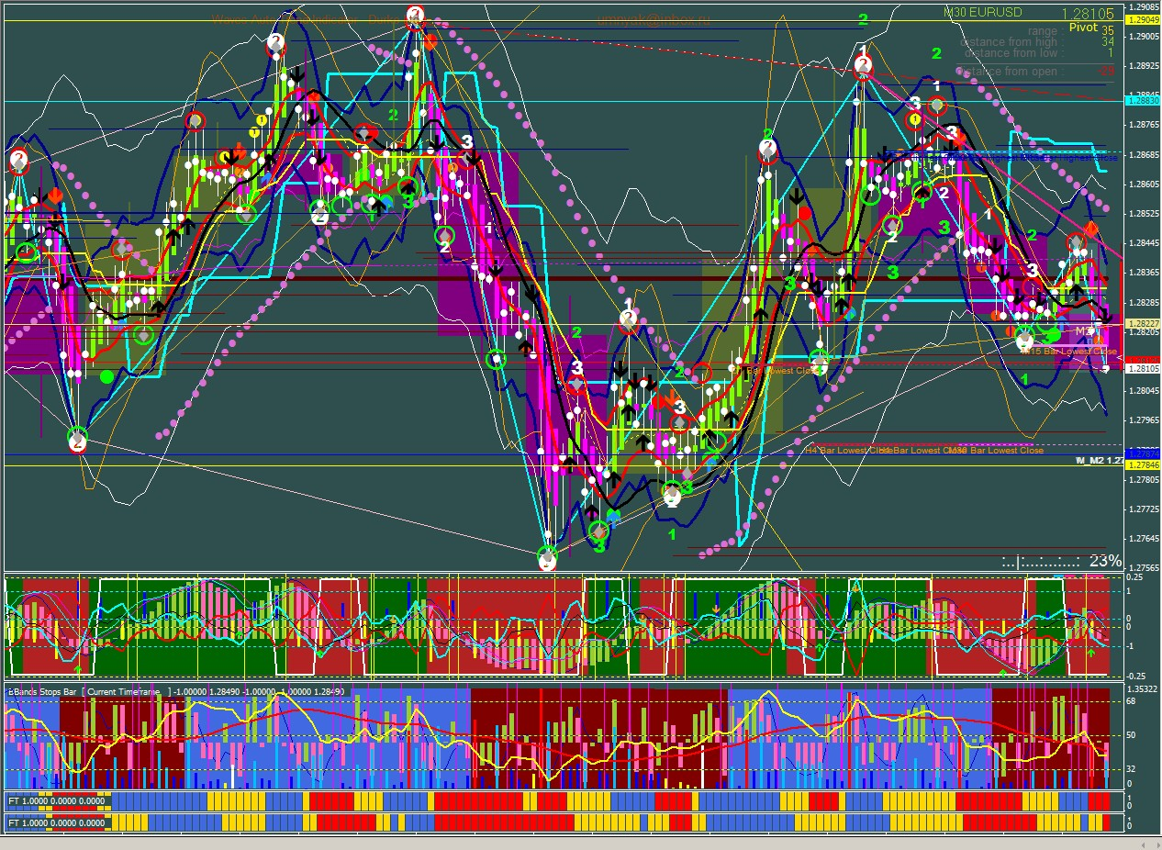
Shall we see some good ol’ graphs?

Slide 20
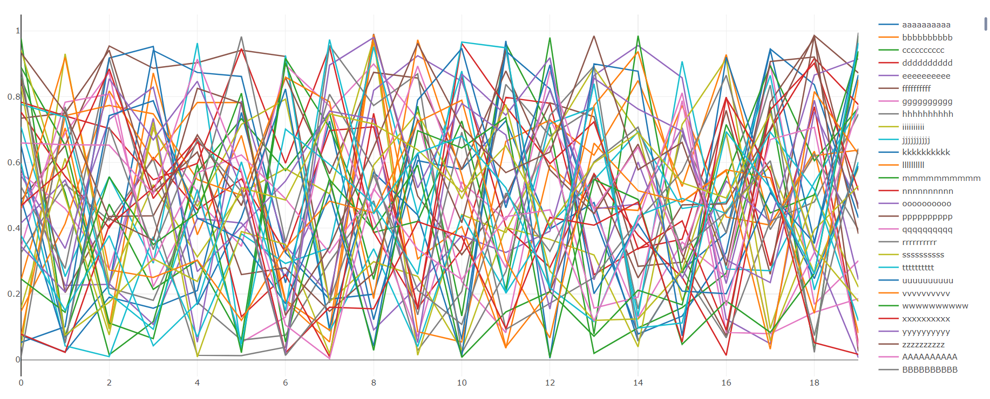
Shall we see some good ol’ graphs?

Slide 21
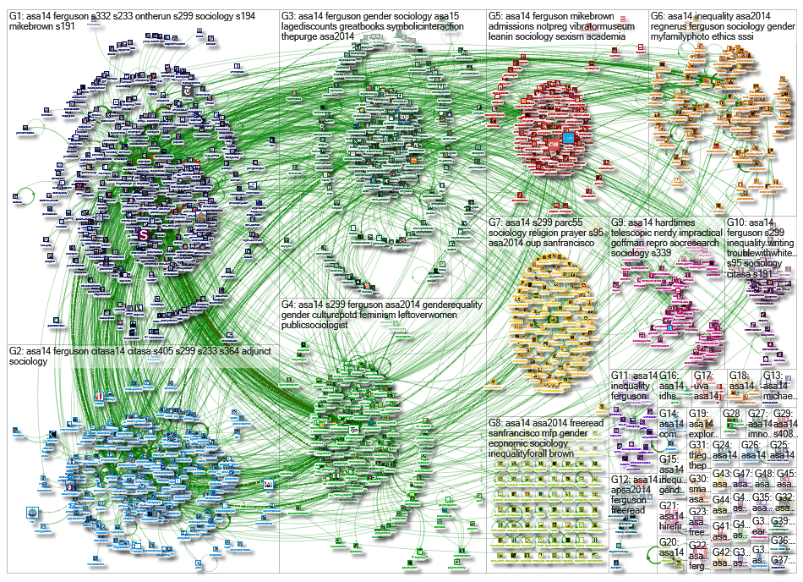
Shall we see some good ol’ graphs?

Slide 22

Let’s go to Streamlit!!

Slide 23
Further implementations
Add women data to be able to compare men and women earnings and abilities on each sport

Slide 24
Further implementations
Add women data to be able to compare men and women earnings and abilities on each sport
Add new sports to our database, because 60 sports are not all the sports that exists, I mean there is no CrossFit… come on!

Slide 25
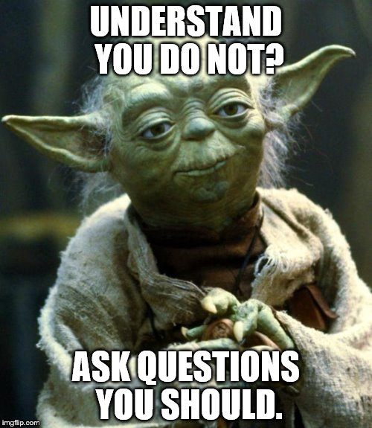
After all this ‘chapa’…. Questions?

Slide 26

Thank you all!
Thanks to all my colleagues
MANY thanks to all the professors
Thank you for keeping up with my DATA DRAMA

